Slide 1

Are There
LOST Books
of The Bible?
Lost Scripture?
Part 2
Additions and Omissions in the Word of God?

Slide 2
Transmission of the Text
Jewish copyists followed strict rules
Thousands of ancient copies of New Testament books
  Earliest confirmed manuscript of the New Testament dates 130 A.D. or before
Copies of the Old and New Testament that date from 325 A.D.
Extensive quotations of the NT from the 2nd and 3rd Century writers

Slide 3
Author | Work | Date | Copy | Time Span | Copies
Homer | Iliad | ~750 B.C. | 400 B.C. | 350 yrs. | 1,800+
Caesar | Gallic Wars | 100-44 B.C. | 900 A.D. | 950 yrs. | 251
Plato | Tetralogies | 427-347 B.C. | 895 A.D. | 1300 yrs. | 210
Apostles | New Testament | 45-96 A.D. | 130 A.D. | 40 yrs. | 5,838 Greek Man.
 |  |  |  |  | 18,524 early trans.

Slide 4
Some Definitions
TR = Textus Receptus (Received Text; Traditional Text)
M = Majority Text (which most often agrees with the TR)
NU = (N) Nestle – Aland and (U) United Bible Societies (Minority Text; Alexandrian Text)
All Bible translations essentially fall under two categories:
Majority Text/
Textus Receptus
Minority Text
Codex:
Sinaiticus,
Vaticanus,
Alexandrinus
Vast amount
of manuscripts
NASB, NIV, NRSV, ERV,
KJV, NKJV, YLT, IGNT

Slide 5
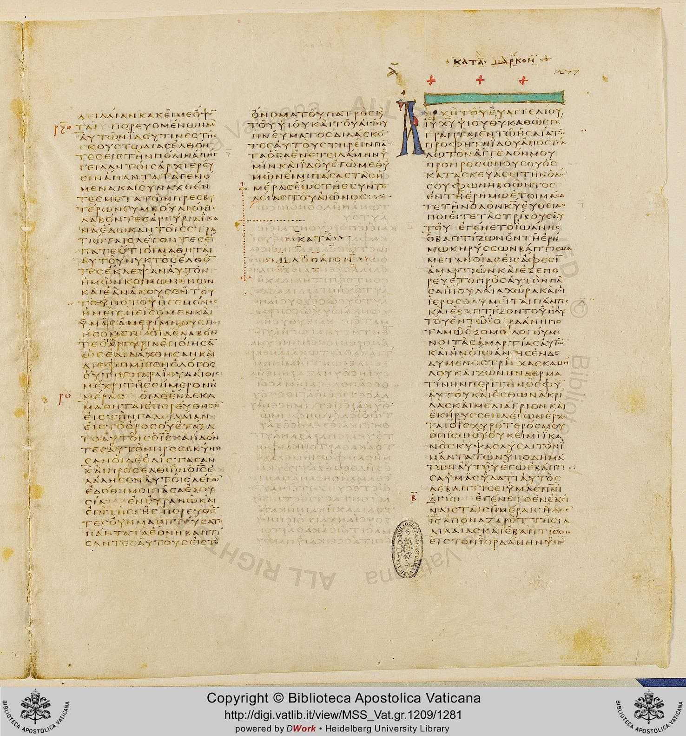
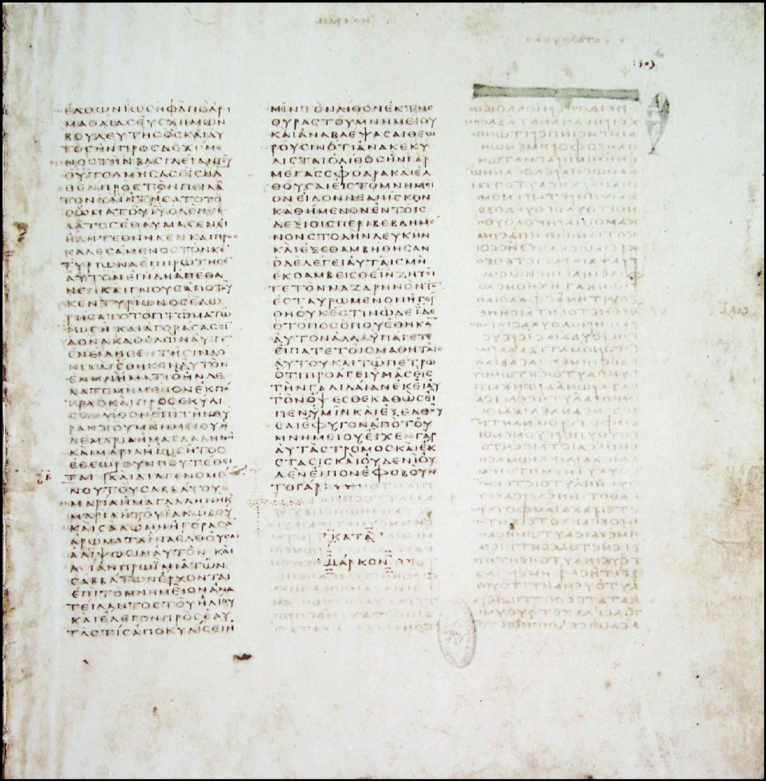
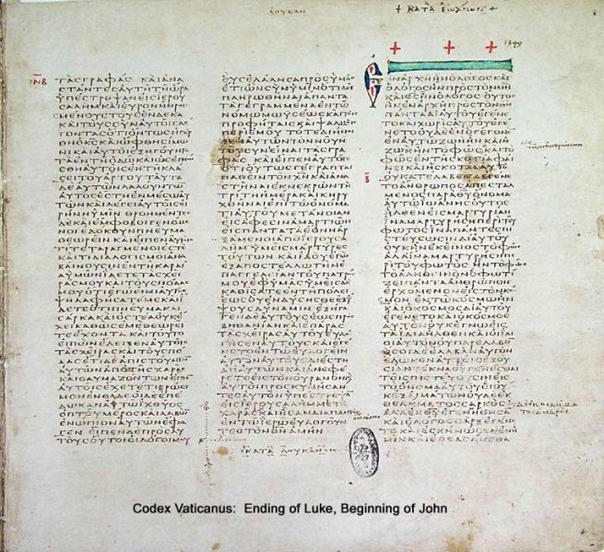
The Strange Blank Column of Mark In Codex Vaticanus
Ending of Matthew
Beginning of Mark
Ending of Luke
Beginning of John
Ending of Mark

Slide 6
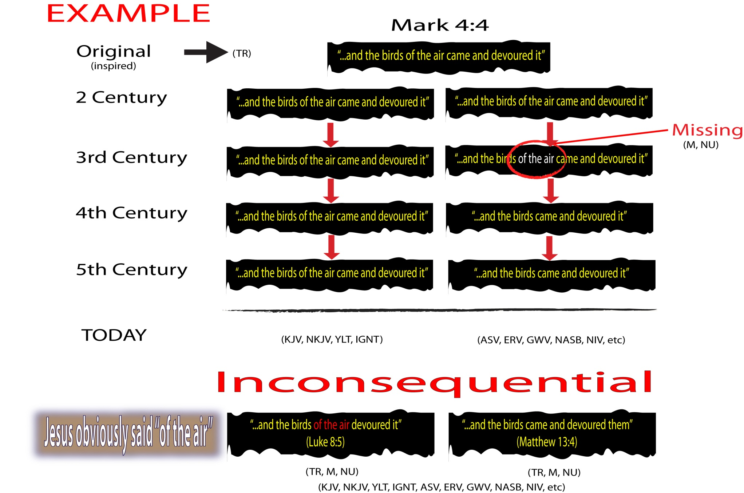

Slide 7
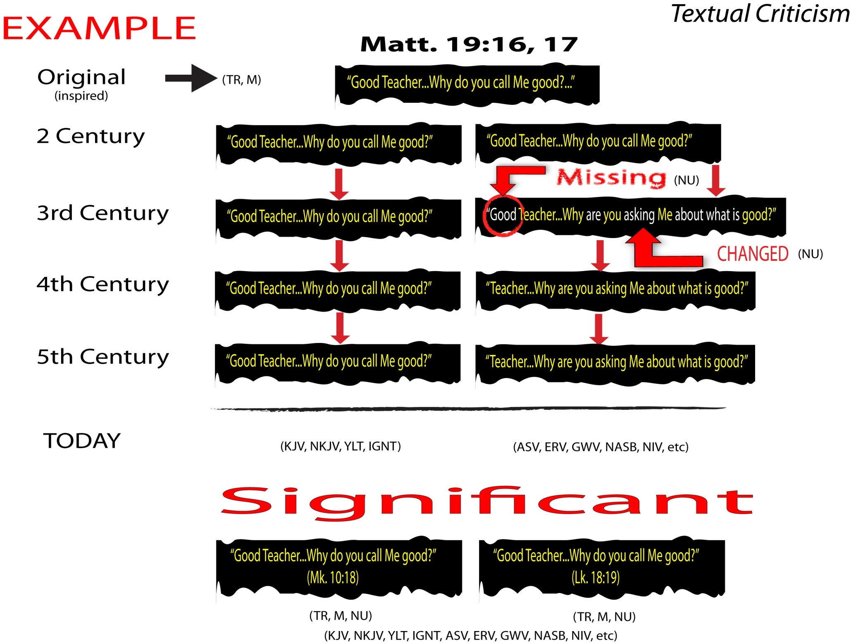

Slide 8
A Word of Caution
About Modern Versions
Most modern versions are based on the Minority Text (Nestle-Aland, Westcott and Hort, so-called, “Critical Text”) which is filled with omissions and notations that lead to confusion regarding God’s word
  ^{BEWARE} of Faulty footnotes: “The most reliable early manuscripts and other ancient witnesses do not have Mark 16:9-20”

Slide 9
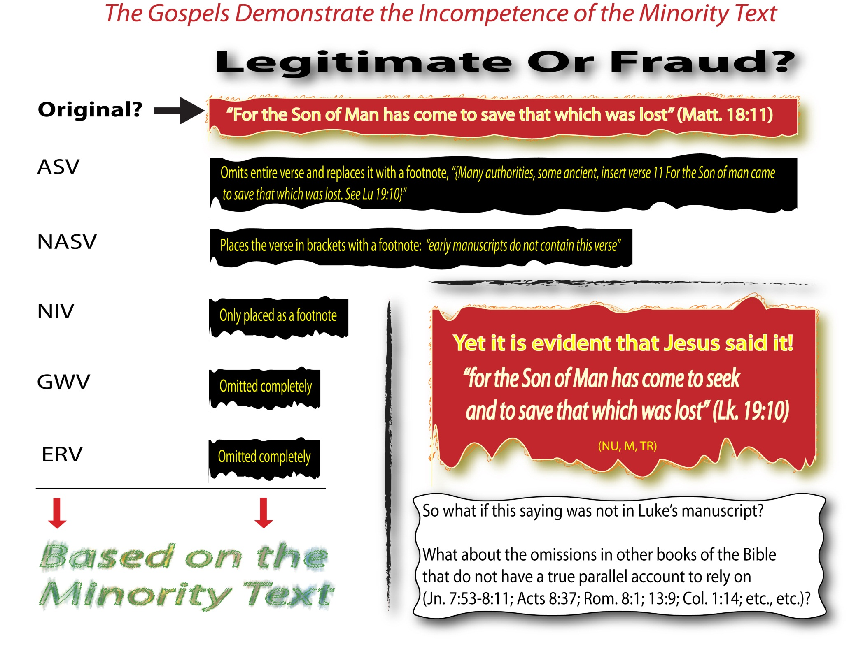

Slide 10
Weak Manuscript Evidence?
When some argue that certain passages from the Textus Receptus have weak manuscript evidence (E.g., Acts 8:37):
They cannot prove it had weak evidence in 1611
As a whole, evidence is often destroyed in time, not gained
Consult second-century quotations

Slide 11
Weak Manuscript Evidence?
“Any critical evaluation of the Textus Receptus in modern times is anachronistic. The integrity of a work must be judged while the same resources used for the work are still in existence, not 300+ years after the creation of the work…Evidence gets destroyed over time. The reason we cannot find as many early manuscripts supporting the minority Textus Receptus readings could be the same reason that we cannot find physical evidence of the Exodus or Noah's ark” (http://www.kjvtoday.com/home/reliable-greek-text/q-arent-some-textus-receptus-readings-based-on-little-manuscript-evidence)

Slide 12
Some of the greater concerns:
Mark 16:9-20 are bracketed in the NU as not original because they are not in the codex Vaticanus or Sinaiticus but are in almost every other manuscript of Mark!
John 7:53-8:11 are bracketed in the NU as not original—yet, they are in over 900 manuscripts of John!
Acts 2:30 the NU omits “according to the flesh He would raise up the Christ.”
Acts 2:47 the NU omits “to the church”
Acts 8:37, the NU, M omit the entire verse
1 Timothy 3:16, the NU replaces “God” with “Who”

Slide 13
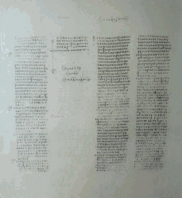
“Several years back I went to the British
Museum, specifically to take a look at
Sinaiticus. To my surprise I discovered
that, while Mark 16:9-20 indeed was
missing, it was clear to see that it had
originally been there, but had been
pumiced (erased) out. The space was
still evident in the codex and the letters
could faintly be seen.
My point is, it was there originally. I could see it with my own eyes! It was at that point that I realized that the note in my New International Version - "The two most reliable early manuscripts do not have Mark 16:9-20", was not telling the whole story! In reality, the verses were originally there!”
(David L. Brown, Ph.D, http://logosresourcepages.org/Versions/uncials.htm)
http://logosresourcepages.org/Versions/uncials.htm

Slide 14
Some Advice
As your primary version, use a translation that is more literal and avoid paraphrases
  Some “readability” will be reduced but accuracy is maintained

Slide 15
The Message (2002)
Psalm 1:1-3
“How well God must like you—
you don’t hang out at Sin Saloon,
you don’t slink along Dead-End Road,
you don’t go to Smart-Mouth College.
² Instead you thrill to God’s Word,
you chew on Scripture day and night.”
New King James Version (1982), Psalm 1:1, 2
“Blessed is the man
Who walks not in the counsel of the ungodly,
Nor stands in the path of sinners,
Nor sits in the seat of the scornful;
² But his delight is in the law of the Lord,
And in His law he meditates day and night.”

Slide 16
The Living Bible (1971)
1 Peter 3:21
“(That, by the way, is what baptism pictures for us: In baptism we show that we have been saved from death and doom by the resurrection of Christ; not because our bodies are washed clean by the water but because in being baptized we are turning to God and asking him to cleanse our hearts from sin.)”
New King James Version (1982), 1 Peter 3:21
“There is also an antitype which now saves us—baptism (not the removal of the filth of the flesh, but the answer of a good conscience toward God), through the resurrection of Jesus Christ”

Slide 17
New Revised Standard Version (1989), 1 Tim. 3:1, 2
“The saying is sure: whoever aspires to the office of bishop desires a noble task. 2 Now a bishop must be above reproach, married only once, temperate, sensible, respectable, hospitable, an apt teacher”
New King James Version (1982), 1 Tim. 3:1, 2
“This is a faithful saying: If a man desires the position of a bishop, he desires a good work. 2 A bishop then must be blameless, the husband of one wife, temperate, sober-minded, of good behavior, hospitable, able to teach”

Slide 18
Some Advice
As your primary version, use a translation that is more literal and avoid paraphrases
Avoid the distraction of using a “Study Bible” for your primary Bible
Consult lexicons for proper word definition and usage
  Consider using: www.blueletterbible.org
Remember, Jesus often quoted and made arguments from a translation of the Hebrew Bible
Be cautious about footnotes in Minority-Text translations
Appreciate the accuracy and reliability of the Old and New Testaments!

Slide 19
The Dead Sea Scrolls prove the accuracy of the copying done. Dated 300-100 B.C., they are nearly identical to the 900 A.D. manuscripts used to translate the Old Testament of the King James Version
  Shows the integrity of the manuscript copyists
  Testifies to the scholarship and reverence of translators down through the ages

Slide 20
Psalm 12:6, 7
6 The words of the LORD are pure words, Like silver tried in a furnace of earth, Purified seven times.
7 You shall keep them, O LORD, You shall preserve them from this generation forever.

